Slide 1
Software Tester

Slide 2

What exactly does a Software Tester do?
You have seen example of really ugly bugs.
You know the definition of a bug and how costly.
So what a tester goal is ?

Slide 3

What exactly does a Software Tester do?
The goal of a software tester is to find bugs.
The goal of a software tester is to find bugs and find them as early as possible.
The goal of a software tester is to find bugs, find them as early as possible, and make sure they get fixed.

Slide 4
Responsibilities on a Testing Team
Responsibilities of a tester
Design test cases
Write test scripts
Implement test cases
Execute test cases
Responsibilities of a QE Lead
Give 25% time for reviewing test cases written
Lead review meetings
Technical expertise on the product
Responsibility of QE manager
Risk Management of the project
Improve communication and issues escalation
Resolve conflicts
Review of the complete QA process

Slide 5
What Makes a Good Software Tester ?
Is easier to destroy rather than create.
Finding Bugs – Written code.
Hard work, Dedication and similar skills.
Testing is in your head
Difference between excellence and mediocre testing
Your test design choices
Your ability to interpret what you observe
Your ability to tell a compelling story about it

Slide 6
Good Software testers are
Explorers
Troubleshooters
Relentless
Creative
Perfectionists
Good judgment
Tactful
Persuasive

Slide 7
Good tester think
Technically
Creatively
Critically
Practically

Slide 8
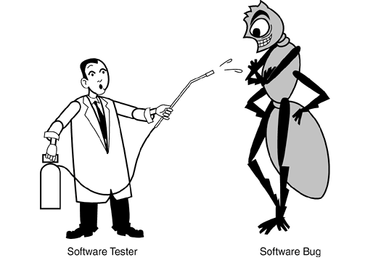
Testing Axioms
It’s impossible to test a Program Completely
Software Testing Is a Risk-Based excecise
Testing Can’t show that Bugs don’t exist
The more Bugs you find the more Bugs there are.
Programmers have bad day.
Programmers often make the same mistake.
Some bugs are really just the tip of the iceberg.

Slide 9
Complete testing is impossible
There are too many possible inputs
Valid inputs
Invalid inputs
Different timing on inputs
There are too many possible control flow paths in the program
Conditionals, loops, switches, interrupts…
Combinatorial explosion
And you would need to retest after every bug fix
Some design errors can’t be found through testing
Specifications may be wrong
You can’t prove programs correct using logic
If the program completely matches the specification, the spec may still be wrong
User interface (and design) issues are too complex

Slide 10
Testing a Program
A program that we want to test reads in 3 integer values – these 3 values are interpreted as the lengths of the sides of a triangle.
The program prints a message that states whether the triangle is
Equilateral (all 3 sides equal)
Isosceles (exactly 2 of the 3 sides are equal)
Scalene (all 3 sides are of a different length)
On a sheet of paper, write specific sets of test data that you feel would adequately test this program.
You don’t have to put your name on the paper.
You have 10 minutes maximum.
© Glenford J. Myers, “The Art of Software Testing”, 1979, p. 1

